Slide 1
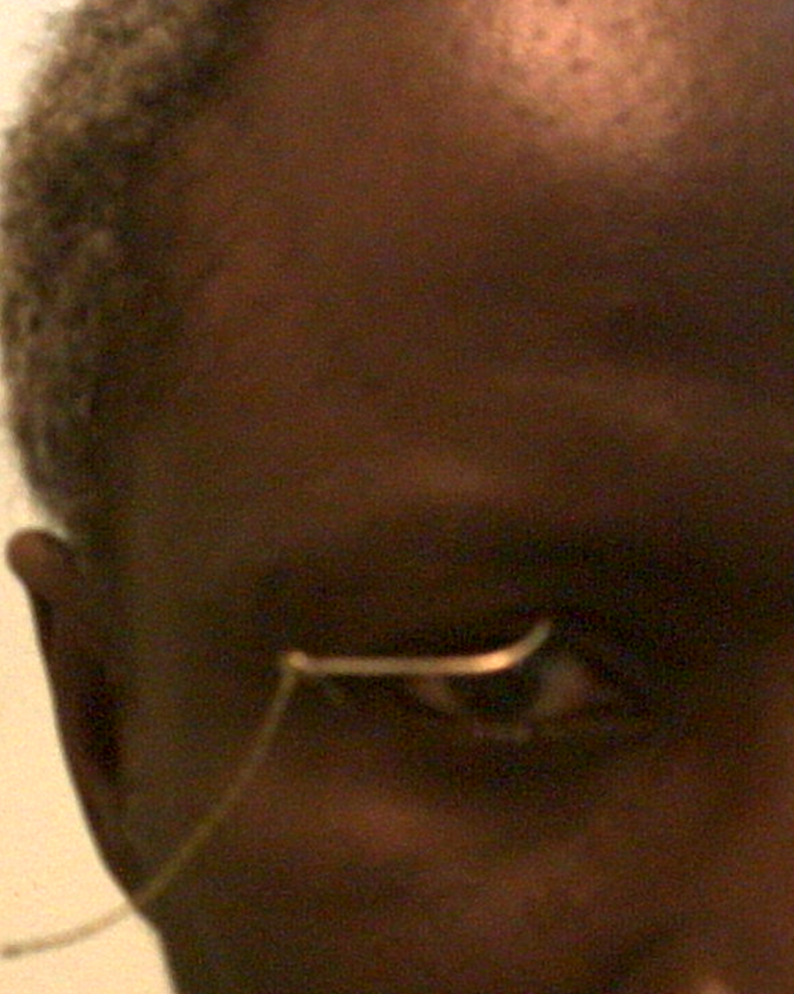
A campaign against ocular injury in children

Slide 2
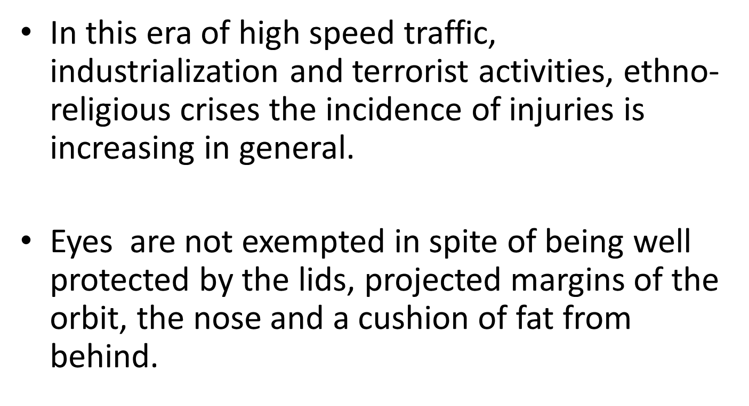
Introduction

Slide 3
Ocular trauma occur in all age
Ocular trauma children is dramatic, unfortunate and common condition, seen in general practice and the eye clinics
Important because;
Blind person year in children is second to cataract
Tendency to loss the vision in the follow eye is higher because of loss of visual field
It occur in almost all setting, recreational, play and sport related activity, workplace, home, agricultural setting, RTAs, intentional.

Slide 4
Consequences
The personal impact is difficult to define, sometime the lifestyle of the victim is permanently altered
Majority ocular trauma are preventable,
it represent a significant problem in the foreseeable future
public health problem

Slide 5
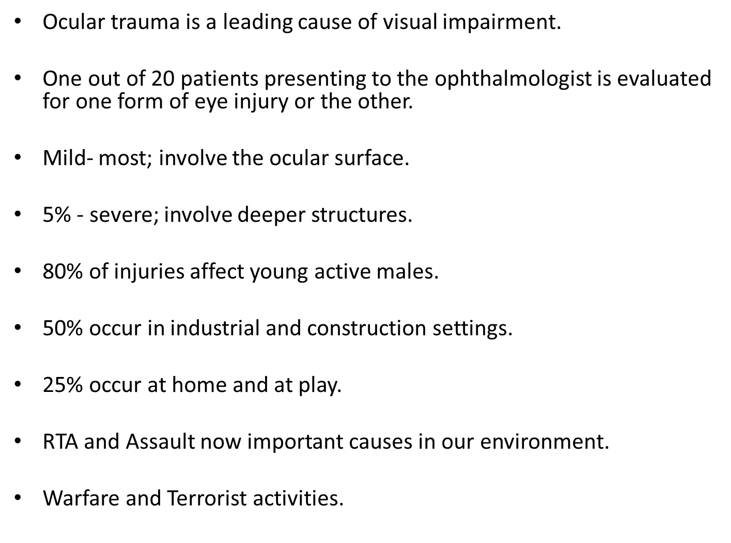

Slide 6
definition
It could be simply define as any damage to ocular structure secondary to an unplanned external physical or chemical contact

Slide 7
A million cause
There is not specific cause of ocular trauma in children
OCULAR TRAUMA IN CHILDREN DO NOT JUST HAPPEN, THEY ARE ACTIVITY RELATED
One classification base on the location and activity of time of injury
-Unsupervised play
-Unsupervised play
-Unsupervised play
-domestic, unsupervised
-sport
-assault
-RTA

Slide 8
Play
Children have the right to play
Play is basic
Play is communicative
Play is expressive
Play is learning to live, not just mere passing of time
Children especially, are more susceptible to eye injuries because of their immature motor skills, and their tendency to imitate adult behavior
THEY DO NOT EVALUATE RISK AND DANGER.
They play with hazardous instrument when left within their reach by adult

Slide 9
OTHERS
source and nature of the injury
-shape/sharpness of object- pointed objects, stick, pencil pleating needle, pen, blunt source-fist, slap, ball, stone
-falls
- Mobile mechanism-guns,missiles and projectiles-stoning, plucking of mangoes
-explosive devices like fireworks, explosion of carbonated drinks in glass bottles, bomb
-chemicals, accidental, TEM

Slide 10
Pencils and why
Why should a child’s pencil be longer than his/her middle finger?
The child only holds it at lowest 1/3
Why should a child pencil be very sharp, except if we are expecting the child to be Leonardo the Vinci at 6years
Why should a child be holding a pencil if he/she is not going to write with it. A pencil is not a toy

Slide 11
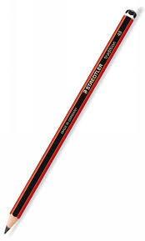
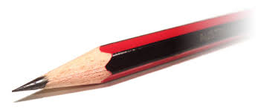


Essence

Slide 12
Burden
Half of all patient who present to the eye casualty do so because of ocular trauma
Globally half a million blinding injury occur every year
1.6million are blind from eye injury
2.3million are bilaterally visually impaired
19million unilateral vision loss, commonest cause of unilateral loss of

Slide 13
Distribution
Male: female 5:1, boys are more adventurous and less supervised, societal values curtail activities of girls
Young adult under 40 are more affect
age depends on region- <15years, accounts for more than 50% of all ocular trauma in some setting trauma occurring the those more 10years usually outdoor, while those less than 6years is usually indoor
Race, black>white, range is variable
Lower socioeconomic class is mostly involved
Close globe injury>open globe injury

Slide 14
A study LUTH group the aetiology into
-FIST- slap, punch of the eye
-GLASS-mostly drink bottles
-METAL- knife, iron scissors, needle, fork
-WOOD-match stick, tree branch
-OTHERS- fall, rope, slap, unknown
The revealed FIST and GLASS are the commonest cause of ocular injury

Slide 15
pathophysiology
4 main mechanism cause ocular injury
-coup
-contra coup
-equatorial expansion
-global reposition

Slide 16
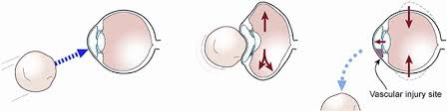
Blunt trauma

Slide 17
Blunt force can cause damage to all ocular structure
Force pushes the globe back into the orbit
Causing compression, stretching and distruption of soft tissues of the eye, cornea, uvea, lens vitreous retina, optic nerve
The thin bony medial wall and the floor can give way
For penetrating force, the wall of the globe can be bridge, foreign body can be lodged

Slide 18
When these happens
Globe may rupture- anterior=uveal prolapse, lens and vitreous herniation,hyphaema, penetrating/ perforation
Posterior rupture=AC appear deep but the IOP is low compare to other eyes
Cornea-corneal abrasion,laceration,FB, corneal oedema
Hyphaema
Iris miosis, mydriasis, iridodialysis
Angle recession glaucoma
Lens-vossius ring, cataract,lens displacement

Slide 19
Posterior segment
PVD, vitreous hemorrhage
Commotio retinae, retinal dialysis, retina tear, retinal hemorrhage, retinal detachment
Macular hole
Choriodal rupture
Traumatic optic neuropathy
Optic nerve avulsion
Endophthalmitis, panophthalmitis,
Toxicity-siderosis,chalcosis

Slide 20
classification
There are several classification of ocular injury
Elizabeth Eagles
BETT,Birmingham Eye Trauma Terminology
OTCS
WHO
Broad sense there are 2 main categories
-close globe injury/blunt injury
-open globe injury/penetrating injury

Slide 21
When examining a patient is very important is very important to determine where the patient belong, cause it has a direct impact on the management
A close globe injury, constitute about 80% of all ocular trauma, may be
-contusion
-lamellar laceration
-superficial FB
-chemical injury
-mixed

Slide 22
Open globe injury, constitutes about 20%,of all ocular injury,
-penetration
-perforation
-ruptured globe
-intraocular FB
-mixed
The extend of the injury is determined by the size, shape, site , speed of the impact and its composition

Slide 23
State of the pupil
Note the present or absent of pupillary reaction/RAPD
Do either direct or indirect/reverse RAPD test
This is prognostic and also a good pointer to the severity

Slide 24
The ocular injury could simply and quickly be graded using VA
Grade 1 VA ≥ 6/12
2 VA 6/15-6/30
3 VA <6/30-6/240
4 VA 6/300-PL
5 NPL

Slide 25
The zone where injury occur is another important indices to note
For open injury,
-zone 1 corneal laceration
-zone 2 corneoscleral laceration 5mm behind the limbus
-zone 3 beyond 5mm

Slide 26
The zone where injury occur is another important indices to note
For open injury,
-zone 1 corneal laceration
-zone 2 corneoscleral laceration 5mm behind the limbus
-zone 3 beyond 5mm

Slide 27
For close injury,
-zone 1 external injury
-zone 2 anterior segment
-zone 3 posterior segment

Slide 28
Assessment
Adequate history: mechanism of injury, source, probable FB, toxicity,infection risk, tetanus status, associated injuries
Examination-globe-rupture(anterior or posterior)
Entry site,and intergrity of wound
Cornea-clarity, stain(FB,abrasions,lacerated ulcers)
Anterior chamber-depth, regular, cells, flare hyphaema
Pupil-miosis, mydriasis, iridodialysis
Iris-hole, prolapse
Lens-vossius ring, cataract, subluxation,luxation

Slide 29
Blunt trauma: Mechanism of damage
Blunt trauma results in anteroposterior compression with resultant increase in the intra ocular pressure and expansion of the globe in the equatorial plane leading to globe rupture in severe cases.
Blunt trauma causes damage by either a direct effect at the point of impact; a contre-coup mechanism at a distant point.
concussion mechanism.

Slide 30
Lids &lashes
Bruises
lacerations +/- involvement of the lid margin; +/-tissue loss/avulsion.
*injury to the lacrimal drainage system
Swelling- fluid (oedema)
- air (subcutaneous emphysema)
-blood(ecchymosis; black eye/panda eyes)

Slide 31



Slide 32
Conjunctiva
Subconjunctival haemorrhage
Conjunctival oedema (chemosis)
Conjunctival lacerations

Slide 33
Cornea
Abrasions: usually very painful, stain with fluorescein.
Rx by ointment, pad. Usually heal within 24-48hrs.
Oedema : due to focal or diffuse endothelial
dysfunction.
Lacerations : either lamellar/partial thickness or full thickness scleral lacerations.
full thickness lacerations +/- uveal prolapse.
*limbal rupture

Slide 34
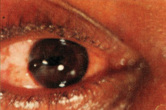
Corneal laceration with uveal prolapse

Slide 35
Anterior chamber
Hyphema: usually from bleeding iris or anterior cilliary vessels.
may be mild/microscopic or severe as in total hyphema.
up to 20% of hyphema re-bleed, usually between 3rd -5th day.
Shallow AC
Deep AC
Irregular AC

Slide 36
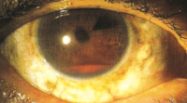
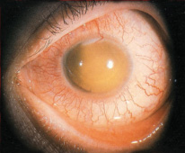
(a) Hyphema (b) corneal blood staining

Slide 37
Iris & Pupil
Traumatic miosis. due to irritation of ciliary nerves with assoc. ciliary spasm.
2. Traumatic mydriasis: due to damage to the pupillary sphincter. May be permanent.
3. Iridodialysis : i.e. detachment of iris from its root at the ciliary body occurs frequently. Characterized by D-shaped pupil.
4. Sphincteric rupture: Rupture of the pupillary margin is a common occurrence in closed-globe injury.

Slide 38
5. Angle recession: A tear between
longitudinal and circular muscle fibers of the
ciliary body.
characterized by deepening of the anterior chamber and widening of the ciliary body band on gonioscopy.
Later complicated by glaucoma.
6. Iris tears
7. Traumatic uveitis: (iridocyclitis).

Slide 39
Lens
Traumatic cataract: due to concussion injury and disruption of lens metabolism.
may occur within minutes or delayed for days to years.
Subluxation of the lens: May occur due to partial tear of zonules.
The subluxated lens is slightly displaced but still present in the pupillary area.
On dilatation of the pupil its edge may be seen.

Slide 40
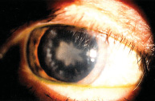
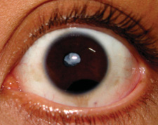
Traumatic cataracts

Slide 41
4. Dislocation of the lens: occurs when rupture of
the zonules is complete.
Dislocation may be intraocular
(anteriorly/posteriorly) or may occasionally be
extruded outside the globe.
Tear of the anterior lens capsule : with leakage of soft lens mater into the AC.
Vossius ring. It is a circular ring of brown pigment seen on the anterior capsule.
It occurs due to striking of the pupillary margin against the crystalline lens.

Slide 42
Vitreous
1. Liquefaction : and appearance of clouds of fine
pigmentary opacities (most common change).
Detachment of the vitreous either anterior or posterior.
3. Vitreous haemorrhage: May give a dark reflex on funduscopy if severe.
4. Vitreous herniation : into the anterior chamber may occur with subluxation or dislocation of the lens, or through a corneoscleral laceration.

Slide 43
Retina
1. oedema :
Commotio retinae: Diffuse retinal oedema.
Berlin’s oedema. Oedema involving the posterior pole (macular) with a ‘cherry-red spot’ in the foveal region.
It may disappear after some days or may be followed by pigmentary changes.
2. Retinal haemorrhages: These are quite common
following concussion trauma. Multiple
haemorrhages including flame-shaped and
pre-retinal (subhyaloid) haemorrhage .
may be associated with traumatic retinopathy.

Slide 44
Retinal tears: These may follow a contusion, particularly in the peripheral region, especially in eyes already suffering from myopia or senile degenerations.
Retinal detachment: It may follow retinal tears or vitreo-retinal tractional bands.
Macular hole

Slide 45
Treatment
Depends on the presentation
Ranges from just reassurance/observation to globe repair, occasionally evisceration or enucleation

Slide 46
Best treatment
Prevention
Safe environment for children
Adult supervision of playing children
Health education

Slide 47
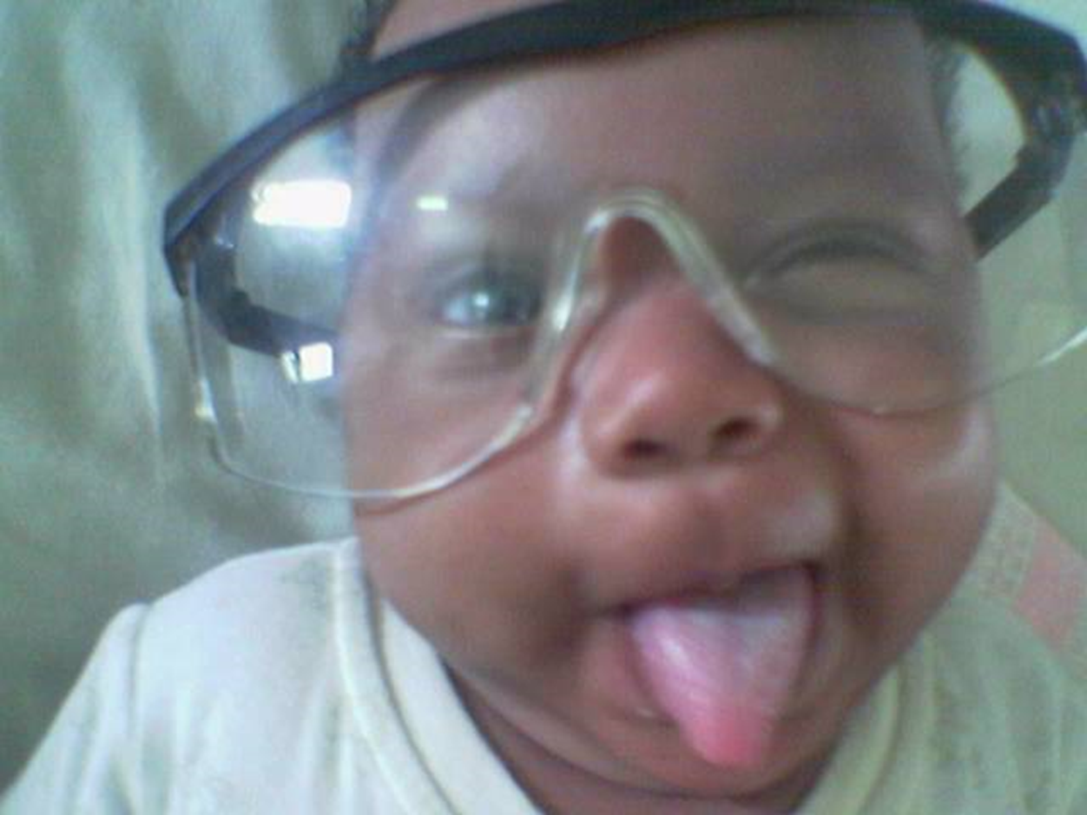
Thanks for listening

